Slide 1


Exposure Java 2015
APCS Edition
Chapter 12 Slides
Dynamic Arrays
with the ArrayList Class
PowerPoint Presentation
created by:
Mr. John L. M. Schram
and Mr. Leon Schram
Authors of Exposure Java

Slide 2
Section 12.1
Introduction

Slide 3
Java Arrays
• Java has a static array capable of easy multi-dimensions.
• Java has a dynamic array, which is also capable of
multi-dimensions, but it is more complex.
• The ArrayList class is used for the dynamic array.
• Static arrays have no methods, but have the initializer list.
• ArrayList is a class with many methods.

Slide 4
Section 12.2
ArrayList
Methods

Slide 5
// Java1201.java
// This program introduces the <ArrayList> class and the <add> method.
// Note that each name is added to the end of the list.
// Ignore the warning messages about "unsafe operations" which
// will be explained later and avoided.
import java.util.ArrayList;
public class Java1201
{
public static void main(String[] args)
{
ArrayList names = new ArrayList();
names.add("Isolde");
names.add("John");
names.add("Greg");
names.add("Maria");
names.add("Heidi");
System.out.println("names contains " + names);
}
}
names contains [Isolde, John, Greg, Maria, Heidi]

Slide 6
ArrayList Method add
names.add("Tom");
The add method allocates space for the newly enlarged array and then stores the new array element at the end of the ArrayList object.

Slide 7
Displaying ArrayList Elements
ArrayList elements can be accessed with various methods.
It is possible to display all the elements inside square brackets, separated by commas by using the println method.
System.out.println(names);
[Isolde, John, Greg, Maria, Heidi]

Slide 8
names contains [Isolde, John, Greg]
There are 3 elements in the names object.
names contains [Isolde, John, Greg, Maria, Heidi]
There are 5 elements in the names object.
// Java1202.java
// This program uses the <size> method to determine the number of elements
// in an <ArrayList> object. The <length> field is only for static arrays.
// Note that the value returned by the <size> method changes when more names
// are added to the <ArrayList> object.
import java.util.ArrayList;
public class Java1202
{
public static void main(String[] args)
{
ArrayList names = new ArrayList();
names.add("Isolde");
names.add("John");
names.add("Greg");
System.out.println("names contains " + names);;
System.out.println("There are " + names.size() + " elements in the names object.");
names.add("Maria");
names.add("Heidi");
System.out.println("names contains " + names);
System.out.println("There are " + names.size() + " elements in the names object.");
}
}

Slide 9



ArrayList Method size
int count = names.size();
The size method returns the number of elements of the ArrayList object names.
Remember Java static arrays use a length field while ArrayList uses a size method.
Don’t confuse
length & size!

Slide 10
// Java1203.java
// This program shows how to access specified elements in an <ArrayList> object
// with the <get(k)> method. This compares to using [k] in static arrays.
import java.util.ArrayList;
public class Java1203
{
public static void main(String[] args)
{
ArrayList names = new ArrayList();
names.add("Isolde");
names.add("John");
names.add("Greg");
names.add("Maria");
names.add("Heidi");
for (int k = 0; k < names.size(); k++)
System.out.println(names.get(k));
System.out.println();
for (int k = names.size()-1; k >= 0; k--)
System.out.println(names.get(k));
}
}
Isolde
John
Greg
Maria
Heidi
Heidi
Maria
Greg
John
Isolde

Slide 11
ArrayList Access
ArrayList objects cannot be accessed with an index [ ] operator, like a Java static array.
All access is performed with ArrayList methods.
ACCESS DENIED!

Slide 12
ArrayList Method get
System.out.println(names.get(3));
The get method accesses a specified array element.
The parameter of the get method is the index of the ArrayList object and starts at 0.
Any attempt to access an element at a
non-existing index results in an IndexOutOfBoundsException error message.

Slide 13
names contains [Isolde, John, Greg, Maria, Heidi]
Heidi
names contains [Isolde, Jessica, Anthony, Haley, Alec]
// Java1204.java
// This program demonstrates the <set> method of the <ArrayList> class, which
// replaces existing elements with a new object.
// Note that the <set> method is a return method that returns the last
// element value before it is replaced.
import java.util.ArrayList;
public class Java1204
{
public static void main(String[] args)
{
ArrayList names = new ArrayList();
names.add("Isolde");
names.add("John");
names.add("Greg");
names.add("Maria");
names.add("Heidi");
System.out.println("names contains " + names);
System.out.println();
names.set(1,"Jessica");
names.set(2,"Anthony");
names.set(3,"Haley");
System.out.println(names.set(4,"Alec"));
System.out.println("names contains " + names);
}
}

Slide 14
ArrayList Method set
names.set(4,"Tom");
The set method uses the first parameter as the index location to find an array element and then replaces it with the value of the second set parameter.
You will get an error if you try to access an index location, which has not been allocated yet.
The set method also returns the last value before replacing it.

Slide 15
names Size: 5
names contains [Isolde, John, Greg, Maria, Heidi]
names contains [Isolde, John, Maria, Heidi]
names contains [Isolde, John, Maria]
names Size: 3
// Java1205.java
// This program demonstrates the <remove> method of the <ArrayList>
// class to delete a specified list element.
// Dynamic arrays change size when they get bigger or smaller.
import java.util.ArrayList;
public class Java1205
{
public static void main(String[] args)
{
ArrayList names = new ArrayList();
names.add("Isolde");
names.add("John");
names.add("Greg");
names.add("Maria");
names.add("Heidi");
System.out.println("names Size: " +names.size());
System.out.println("names contains " + names);
System.out.println();
names.remove(2);
System.out.println("names contains " + names);
System.out.println();
names.remove(3);
System.out.println("names contains " + names);
System.out.println("names Size: " +names.size());
}
}

Slide 16
ArrayList Method remove
names.remove(3);
The remove method removes the array element at the index location of its parameter and decreases the object size by one array element.

Slide 17
names contains [Isolde, John, Greg, Maria, Heidi]
names contains [Isolde, John, Jessica, Greg, Maria, Heidi]
names contains [Isolde, John, Jessica, Anthony, Greg, Maria, Heidi]
// Java1206.java
// This program demonstrates how to use the overloaded <add> method of the
// <ArrayList> class to insert new elements at a specified location.
import java.util.ArrayList;
public class Java1206
{
public static void main(String[] args)
{
ArrayList names = new ArrayList();
names.add("Isolde");
names.add("John");
names.add("Greg");
names.add("Maria");
names.add("Heidi");
System.out.println("names contains " + names);
System.out.println();
names.add(2,"Jessica");
System.out.println("names contains " + names);
System.out.println();
names.add(3,"Anthony");
System.out.println("names contains " + names);
}
}

Slide 18
ArrayList Method add
(2nd Overloaded method)
names.add(3,"Kathy");
The overloaded add(3,"Kathy") method adds or rather inserts a new array element at the indicated index.

Slide 19


AP Exam Alert
The ArrayList class is tested on the AP exam
with the following six methods:
int size()
boolean add(E obj)
void add(int index, E obj)
E get(int index)
E set(int index, E obj)
E remove(int index)
In the method headings above E is the data type of the Element that is added or returned.

Slide 20
Section 12.3
ArrayList
and Primitive
Datatypes

Slide 21
// Java1207.java
// This program demonstrates how <int> values stored into an <ArrayList> object are first
// converted to <Integer> objects. The <Integer> class is called a "wrapper" class.
import java.util.ArrayList;
public class Java1207
{
public static void main(String[] args)
{
ArrayList numbers = new ArrayList();
for (int k = 1; k <= 500; k++)
{
int rndInt = (int) (Math.random() * 900 + 100);
numbers.add(new Integer(rndInt));
System.out.print(rndInt + " ");
if (k % 15 == 0)
System.out.println();
}
int sum = 0;
for (int k = 0; k < numbers.size(); k++)
{
Integer temp = (Integer) numbers.get(k);
sum += temp.intValue();
}
System.out.println("\n\nSum: " + sum);
}
}

Slide 22
637 402 417 787 501 596 480 240 416 904 284 227 917 372 716
799 283 771 543 198 906 232 336 420 212 942 679 969 344 875
561 977 979 634 621 319 940 432 406 778 659 656 315 194 619
150 983 813 812 300 252 645 573 815 847 744 247 402 938 673
756 350 724 334 412 181 431 621 308 584 221 622 770 904 990
984 750 775 794 268 543 832 988 834 988 730 741 741 940 346
702 189 396 564 539 920 407 357 382 951 391 577 230 626 851
756 753 406 512 452 454 404 733 443 102 268 551 804 946 436
639 752 365 495 726 427 483 747 367 767 610 414 166 816 619
620 984 275 672 238 569 968 558 756 351 226 998 758 440 792
355 236 515 677 311 139 724 172 228 364 613 945 985 468 502
770 151 699 449 606 800 910 387 759 526 723 526 200 325 486
869 826 479 981 741 740 534 383 181 383 426 493 197 426 564
444 983 978 484 942 765 722 363 907 287 797 946 467 216 839
596 896 283 386 440 622 500 438 495 671 521 346 227 792 336
838 877 500 565 783 827 452 857 700 873 906 131 804 763 234
211 327 532 304 168 195 271 129 908 178 989 624 443 232 416
633 872 116 427 294 248 794 900 220 549 721 461 928 925 194
972 802 153 138 928 337 187 740 858 615 973 843 851 460 795
788 482 118 559 449 225 587 579 162 541 819 677 290 145 422
354 135 451 555 286 943 850 895 752 117 493 691 973 874 177
736 664 576 406 412 274 246 547 568 277 395 419 319 738 389
413 373 241 441 113 878 727 536 350 741 404 203 661 347 662
787 175 520 902 617 878 700 150 729 609 801 486 389 287 529
349 449 736 228 727 286 986 980 966 996 714 113 633 451 350
551 397 703 540 284 668 270 136 776 540 151 280 107 251 684
151 862 944 947 207 463 980 941 709 141 489 761 425 862 114
912 482 382 693 813 653 521 497 536 931 251 500 835 207 756
317 753 766 524 491 835 202 853 126 642 168 186 525 433 359
512 869 979 476 681 203 264 107 594 196 383 619 689 100 248
377 402 858 103 758 936 130 583 966 788 209 477 443 981 622
715 206 956 260 160 426 732 223 771 352 501 564 498 376 763
263 290 691 426 327 515 270 269 244 960 228 700 371 603 889
657 840 558 510 259
Sum: 274662

Slide 23
ArrayList and
Primitive Data Types
The ArrayList class can only store Object values.
Primitive data type values can be stored indirectly using wrapper classes.
The Integer class
wraps int values.
The Double class
wraps double values.
The Boolean class
wraps boolean values.

Slide 24
Section 12.4
ArrayList
& Generics

Slide 25
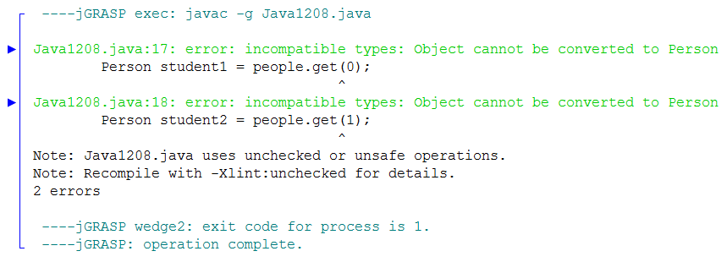
// Java1208.java
// This program has no output, which does not matter, because it does not compile.
// You will see two "incompatible types" syntax errors. This may seem strange
// because the <ArrayList> object stores <Person> objects.
import java.util.ArrayList;
public class Java1208
{
public static void main(String[] args)
{
ArrayList people = new ArrayList();
people.add(new Person("Joe",21));
people.add(new Person("Sue",20));
Person student1 = people.get(0);
Person student2 = people.get(1);
}
}
class Person
{
private String name;
private int age;
public Person (String n, int a)
{
name = n;
age = a;
}
}

Slide 26
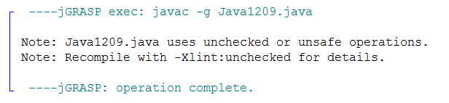
// Java1209.java
// This program compiles and there is still no output. Output is not the
// issue. Understanding the correct syntax involved does matter.
// In this case lines 18 and 19 cast to the <Person> class, which makes
// Java happy. Without casting the data types are unknown.
import java.util.ArrayList;
public class Java1209
{
public static void main(String[] args)
{
ArrayList people = new ArrayList();
people.add(new Person("Joe",21));
people.add(new Person("Sue",20));
Person student1 = (Person) people.get(0); // Line 18
Person student2 = (Person) people.get(1); // Line 19
}
}
class Person
{
private String name;
private int age;
public Person (String n, int a)
{
name = n;
age = a;
}
}

Slide 27
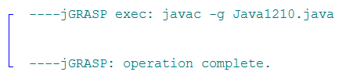
// Java1210.java
// Since Java Version 5.0 the "casting" solution of the last program is so
// "old Java version". It is now possible to specify, at the time that the
// <ArrayList> object is constructed, what kind of object is stored.
// Note: the "unsafe operations" warning is now also gone.
import java.util.ArrayList;
public class Java1210
{
public static void main(String[] args)
{
ArrayList<Person> people = new ArrayList<Person>();
people.add(new Person("Joe",21));
people.add(new Person("Sue",20));
Person student1 = people.get(0);
Person student2 = people.get(1);
}
}
class Person
{
private String name;
private int age;
public Person (String n, int a)
{
name = n;
age = a;
}
}

Slide 28
// Java1211.java
// This program shows another benefit of using generics.
// There are two <ArrayList> objects and both are constructed to store <Integer>
// values. After three values are entered in the <numbers1> object, those values are
// then assigned to <numbers2>, which works without problems.
import java.util.ArrayList;
public class Java1211
{
public static void main(String[] args)
{
ArrayList<Integer> numbers1 = new ArrayList<Integer>();
numbers1.add(new Integer(100));
numbers1.add(new Integer(200));
numbers1.add(new Integer(300));
System.out.println(numbers1);
ArrayList<Integer> numbers2 = new ArrayList<Integer>();
numbers2.add(numbers1.get(0));
numbers2.add(numbers1.get(1));
numbers2.add(numbers1.get(2));
System.out.println(numbers2);
}
}
[100, 200, 300]
[100, 200, 300]

Slide 29
// Java1212.java
// Generics make sure that an array is in fact an array. An array
// is supposed to be a data structure with elements of the same type.
// This program example - which does not use generics - allows the
// list array to store three different data types.
import java.util.ArrayList;
public class Java1212
{
public static void main(String[] args)
{
ArrayList list = new ArrayList();
list.add(new Double(3.14159));
list.add(new Integer(200));
list.add(new String("Dubrovnik"));
System.out.println(list);
}
}
[3.14159, 200, Dubrovnik]
This violates
the definition
of an array.

Slide 30
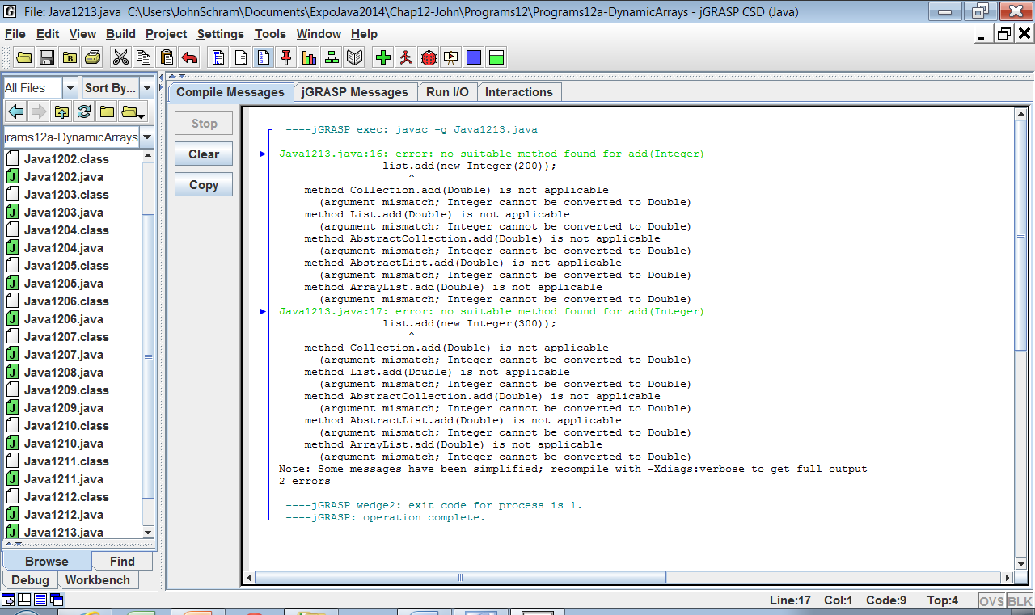
// Java1213.java
// Once generics are used, Java becomes very picky. If you want to create
// an <ArrayList> object to store <Double> values, such as is shown below,
// then only <Double> values must be added. The attempt to add one
// <Double> and two <Integer> objects results in two errors.
import java.util.ArrayList;
public class Java1213
{
public static void main(String[] args)
{
ArrayList<Double> list = new ArrayList<Double>();
list.add(new Double(3.14159));
list.add(new Integer(200));
list.add(new Integer(300));
System.out.println(list);
}
}

Slide 32
Section 12.5
ArrayList and the
Enhanced for Loop

Slide 33
// Java1214.java
// This program shows three ways to display the members of an <ArrayList> object.
// The enhanced <for..each> loop works very well with <ArrayList> objects.
import java.util.ArrayList;
public class Java1214
{
public static void main(String[] args)
{
ArrayList<String> names = new ArrayList<String>();
names.add("Isolde");
names.add("John");
names.add("Greg");
names.add("Maria");
names.add("Heidi");
System.out.println(names);
System.out.println();
for (int index = 0; index < names.size(); index++)
System.out.println(names.get(index));
System.out.println();
for (String name: names)
System.out.println(name);
}
}
Isolde
John
Greg
Maria
Heidi

Slide 34
Section 12.6
The Deck Class
With ArrayList

Slide 35

// Card.java 12-26-14
// This is the "unit" class that stores information about a single card.
// *********************************************************************
// The "Elevens" AP Lab is created for the College Board APCS
// curriculum by Michael Clancy, Robert Glen Martin and Judith Hromcik.
// Leon Schram has altered this "Elevens" AP Lab file to focus on
// CS topics as the "Elevens" Lab is integrated into the curriculum.
public class Card
{
private String suit;
private String rank;
private int value;
public Card(String s, String r, int v) { suit = s; rank = r; value = v; }
public String getSuit() { return suit; }
public String getRank() { return rank; }
public int getValue() { return value; }
public boolean matches(Card otherCard)
{
return otherCard.getSuit().equals(this.suit)
&& otherCard.getRank().equals(this.rank)
&& otherCard.getValue() == this.value;
}
public String toString() { return "[" + suit + ", " + rank + ", " + value + "]"; }
}

Slide 36
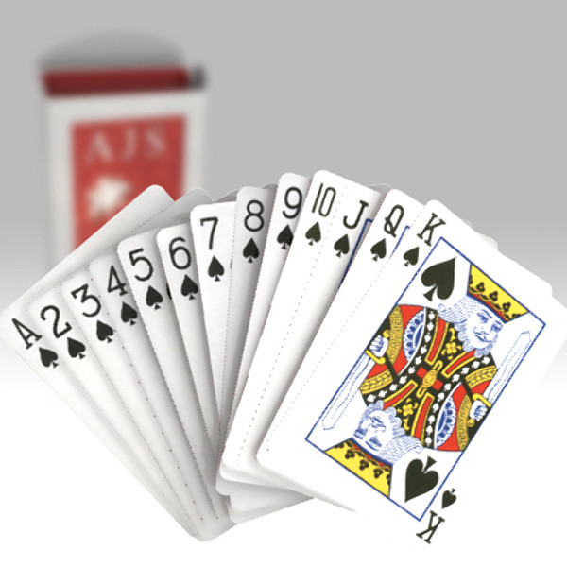
// Deck01.java 12-26-14
// This is the first stage of the Deck class, as introduced
// in the previous "Static Arrays" chapter.
// This version is implemented with "dynamic arrays".
// ********************************************************************
// The "Elevens" AP Lab is created for the College Board APCS
// curriculum by Michael Clancy, Robert Glen Martin and Judith Hromcik.
// Leon Schram has altered this "Elevens" AP Lab file to focus on
// CS topics as the "Elevens" Lab is integrated into the curriculum.
import java.util.ArrayList;
public class Deck01
{
private ArrayList<Card> cards;
private int size;
public Deck01()
{
cards = new ArrayList<Card>();;
size = 0;
}
public int getSize() { return size; }
public boolean isEmpty() { return size == 0; }
}

Slide 37
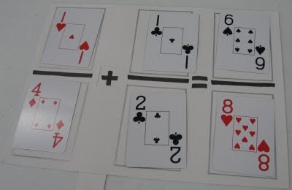
// DeckTester01.java 12-26-14
// This program tests the "dynamic array" Deck01 class.
// ********************************************************************
// The "Elevens" AP Lab is created for the College Board APCS
// curriculum by Michael Clancy, Robert Glen Martin and Judith Hromcik.
// Leon Schram has altered this "Elevens" AP Lab file to focus on
// CS topics as the "Elevens" Lab is integrated into the curriculum.
public class DeckTester01
{
public static void main(String[] args)
{
Deck01 deck = new Deck01();
System.out.println(deck);
System.out.println(deck.getSize());
System.out.println(deck.isEmpty());
}
}
Deck01@1db9742
0
true

Slide 38
// Deck02.java 12-26-14
// Methods <add> and <display> are added to the <Deck02> class.
// Objects of the <Card> class can now be stored in the <cards> array.
// This version is implemented with "dynamic arrays"
// ********************************************************************
// The "Elevens" AP Lab is created for the College Board APCS
// curriculum by Michael Clancy, Robert Glen Martin and Judith Hromcik.
// Leon Schram has altered this "Elevens" AP Lab file to focus on
// CS topics as the "Elevens" Lab is integrated into the curriculum.
import java.util.ArrayList;
public class Deck02
{
private ArrayList<Card> cards;
private int size;
public Deck02()
{
cards = new ArrayList<Card>();
size = 0;
}
public int getSize()
{
return size;
}
public boolean isEmpty()
{
return size == 0;
}
public void add(String suit,
String rank, int value)
{
Card temp =
new Card(suit,rank,value);
cards.add(temp);
size++;
}
public void display()
{
for (Card card: cards)
System.out.println(card);
}
}

Slide 39
// DeckTester02.java 12-26-14
// This program tests the <Deck02> class.
// This program tests the "dynamic array" Deck02 class.
// ********************************************************************
// The "Elevens" AP Lab is created for the College Board APCS
// curriculum by Michael Clancy, Robert Glen Martin and Judith Hromcik.
// Leon Schram has altered this "Elevens" AP Lab file to focus on
// CS topics as the "Elevens" Lab is integrated into the curriculum
public class DeckTester02
{
public static void main(String[] args)
{
Deck02 deck = new Deck02();
deck.add("Clubs","Three",3);
deck.add("Diamonds","Four",4);
deck.add("Hearts","Five",5);
deck.add("Spades","Six",6);
deck.display();
System.out.println(deck.getSize());
System.out.println(deck.isEmpty());
}
}
[Clubs, Three, 3]
[Diamonds, Four, 4]
[Hearts, Five, 5]
[Spades, Six, 6]
4
false

Slide 40

// Deck03.java 12-26-14
// The <display> method is now replaced by the <toString> method.
// This version is implemented with "dynamic arrays".
// ********************************************************************
// The "Elevens" AP Lab is created for the College Board APCS
// curriculum by Michael Clancy, Robert Glen Martin and Judith Hromcik.
// Leon Schram has altered this "Elevens" AP Lab file to focus on
// CS topics as the "Elevens" Lab is integrated into the curriculum.
import java.util.ArrayList;
public class Deck03
{
private ArrayList<Card> cards;
private int size;
public Deck03() { cards = new ArrayList<Card>(); size = 0; }
// all other methods are the same as Deck02
public String toString()
{
String temp = "";
for (int k = 0; k < size; k++)
temp = temp + cards.get(k).toString() + "\n";
return temp;
}
}

Slide 41
// DeckTester03.java 12-26-14
// This program tests the Deck03 class.
// This program tests the "dynamic array" Deck03 class.
// ********************************************************************
// The "Elevens" AP Lab is created for the College Board APCS
// curriculum by Michael Clancy, Robert Glen Martin and Judith Hromcik.
// Leon Schram has altered this "Elevens" AP Lab file to focus on
// CS topics as the "Elevens" Lab is integrated into the curriculum.
public class DeckTester03
{
public static void main(String[] args)
{
Deck03 deck = new Deck03();
deck.add("Clubs","Three",3);
deck.add("Diamonds","Four",4);
deck.add("Hearts","Five",5);
deck.add("Spades","Six",6);
System.out.println(deck);
System.out.println(deck.getSize());
System.out.println(deck.isEmpty());
}
}
[Clubs, Three, 3]
[Diamonds, Four, 4]
[Hearts, Five, 5]
[Spades, Six, 6]
4
false

Slide 42
Section 12.7
Review of the
Magpie Program

Slide 43
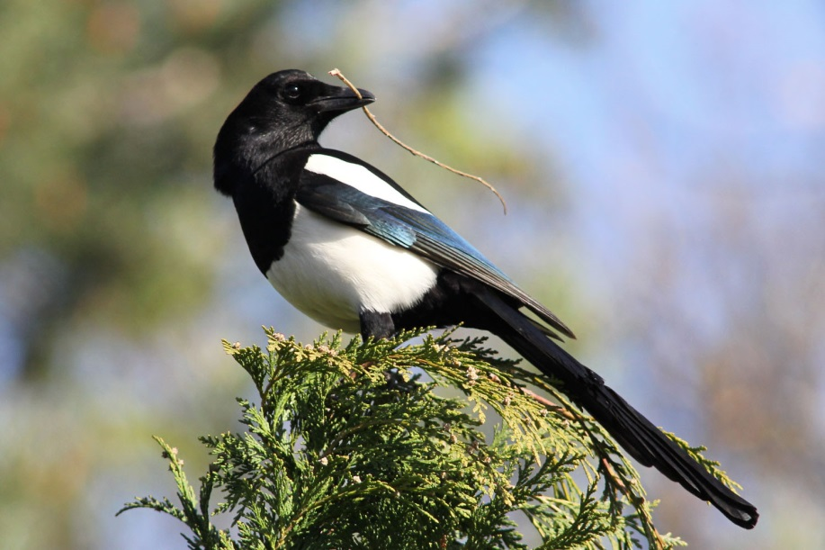
// Magpie01.java 12-26-14
// This "Magpie" version looks only at the "negative" response
// and considers all the different cases of a "no" substring.
//****************************************************************
// The "Magpie" AP Lab is created for the College Board APCS
// curriculum by Laurie White.
// Leon Schram has altered this "Magpie" file to focus on
// CS topics as the "Magpie" Lab is integrated into the curriculum.
public class Magpie01
{
public String getGreeting() { return "Hello, let's talk."; }
public String getResponse(String statement)
{
String response = "";
if (statement.length() == 0)
{
response = "Say something, please.";
}
else if (findKeyword(statement, "no") >= 0)
{
response = "Why so negative?";
}
else
{
response = "I don't know what to say";
}
return response;
}

Slide 44
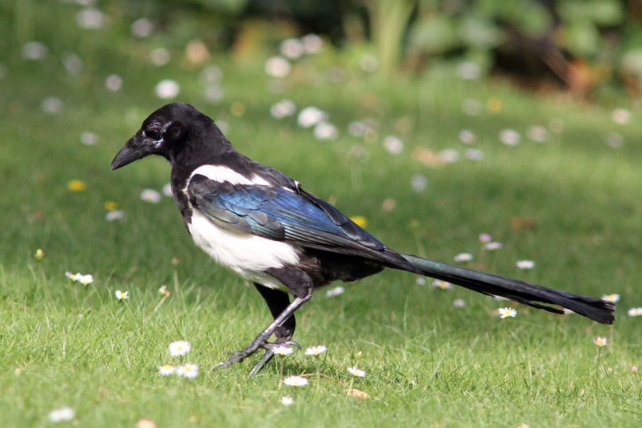
private int findKeyword(String statement, String goal,int startPos)
{
String phrase = statement.trim();
int psn = phrase.toLowerCase().indexOf(goal.toLowerCase(), startPos);
while (psn >= 0)
{
String before = " ", after = " ";
if (psn > 0)
{
before = phrase.substring(psn - 1, psn).toLowerCase();
}
if (psn + goal.length() < phrase.length())
{
after = phrase.substring(
psn + goal.length(),psn + goal.length() + 1).toLowerCase();
}
if (((before.compareTo("a") < 0) || (before.compareTo("z") > 0))
&& ((after.compareTo("a") < 0) || (after.compareTo("z") > 0)))
{
return psn;
}
psn = phrase.indexOf(goal.toLowerCase(),psn + 1);
}
return -1;
}
private int findKeyword(String statement, String goal)
{
return findKeyword(statement, goal, 0);
}
}

Slide 45
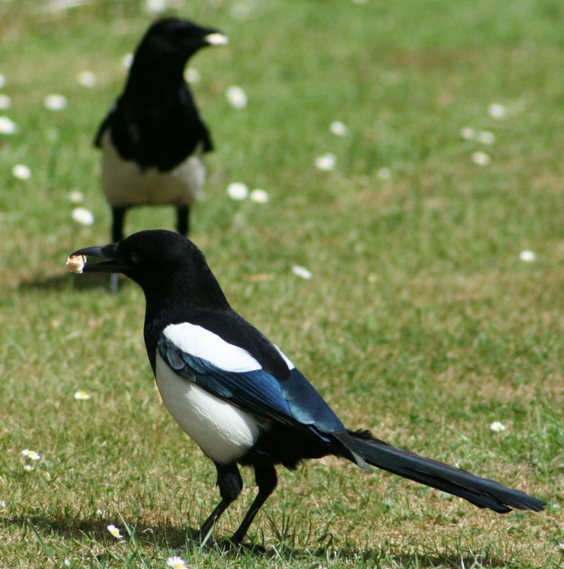
// MagpieTester01.java 12-26-14
// This program tests the Magpie01 class.
// ***************************************************************
// The "Magpie" AP Lab is created for the College Board APCS
// curriculum by Laurie White.
// Leon Schram has altered this "Magpie" file to focus on
// CS topics as the "Magpie" Lab is integrated into the curriculum.
import java.util.Scanner;
public class MagpieTester01
{
public static void main(String[] args)
{
Magpie01 maggie = new Magpie01();
System.out.println (maggie.getGreeting());
Scanner in = new Scanner (System.in);
String statement = in.nextLine();
while (!statement.equals("Bye"))
{
System.out.println (maggie.getResponse(statement));
statement = in.nextLine();
}
}
}

Slide 46
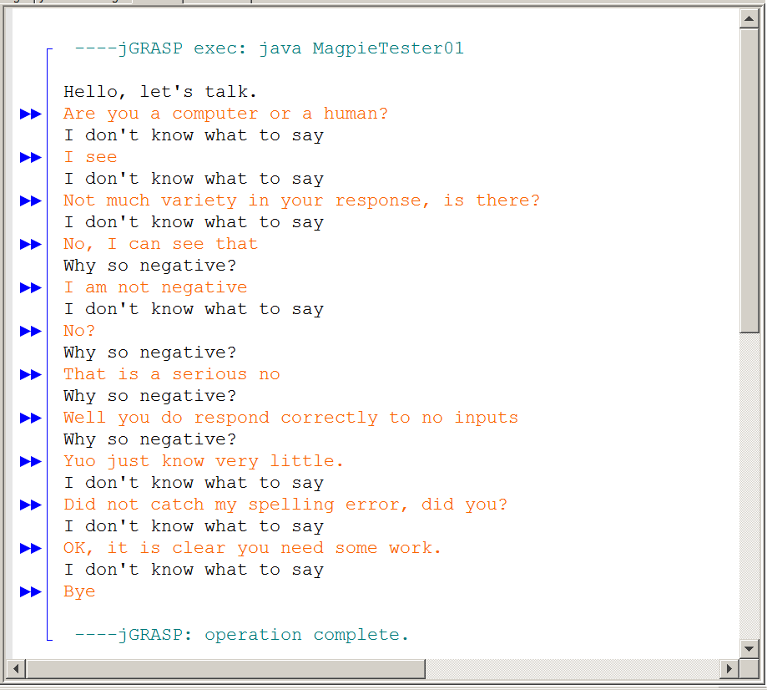

Slide 47

// Magpie02.java 12-26-14
// This Magpie version provides the following responses:
// 1. "Why so negative" when substring "no" is found.
// (This is the simplistic version for any "no" anywhere)
// 2. "Tell me more about your family" when relatives are found.
// 3. Otherwise one of four random responses is provided.
//****************************************************************
// The "Magpie" AP Lab is created for the College Board APCS curriculum by Laurie White.
// Leon Schram has altered this "Magpie" file to focus on
// CS topics as the "Magpie" Lab is integrated into the curriculum.
public class Magpie02
{
public String getGreeting() { return "Hello, let's talk."; }
public String getResponse(String statement)
{
String response = "";
if (statement.indexOf("no") >= 0) {
response = "Why so negative?";
}
else if (statement.indexOf("mother") >= 0
|| statement.indexOf("father") >= 0
|| statement.indexOf("sister") >= 0
|| statement.indexOf("brother") >= 0)
{
response = "Tell me more about your family.";
}
else {
response = getRandomResponse();
}
return response;
}

Slide 48

private String getRandomResponse()
{
final int NUMBER_OF_RESPONSES = 4;
double r = Math.random();
int whichResponse = (int)(r * NUMBER_OF_RESPONSES);
String response = "";
if (whichResponse == 0)
{
response = "Interesting, tell me more.";
}
else if (whichResponse == 1)
{
response = "Hmmm.";
}
else if (whichResponse == 2)
{
response = "Do you really think so?";
}
else if (whichResponse == 3)
{
response = "You don't say.";
}
return response;
}
}

Slide 49
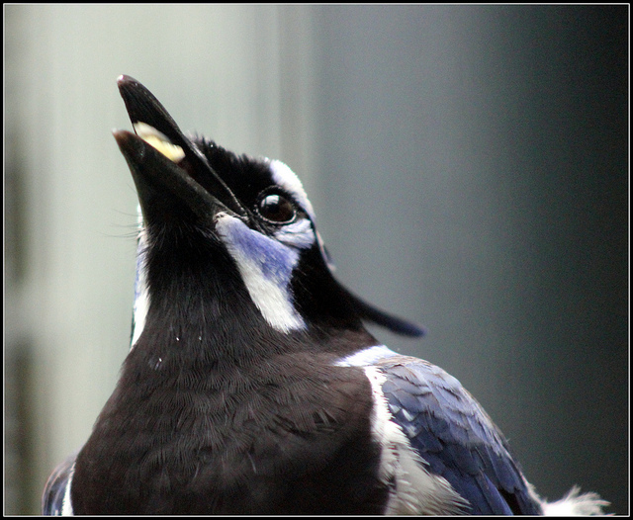
// MagpieTester02.java 12-26-14
// This program tests the Magpie02 class.
// ***************************************************************
// The "Magpie" AP Lab is created for the College Board APCS
// curriculum by Laurie White.
// Leon Schram has altered this "Magpie" file to focus on
// CS topics as the "Magpie" Lab is integrated into the curriculum.
import java.util.Scanner;
public class MagpieTester02
{
public static void main(String[] args)
{
Magpie02 maggie = new Magpie02();
System.out.println (maggie.getGreeting());
Scanner in = new Scanner (System.in);
String statement = in.nextLine();
while (!statement.equals("Bye"))
{
System.out.println (maggie.getResponse(statement));
statement = in.nextLine();
}
}
}

Slide 50
